Slide 1
NG PMIC FB loop MATLAB Modeling

Slide 2
Introduction
To predict the Next Gen PMIC FB loop behavior with high accuracy stability analysis is needed with the following steps :
Modeling the FB loop in small signal laplace domain – Benchmark different models.
Calculate the required compensation transfer function – analytically
Fine tune the Digital Voltage loop transfer function to behave like the analytical calculation
Feed the new PID settings into AMS simulation

Slide 3
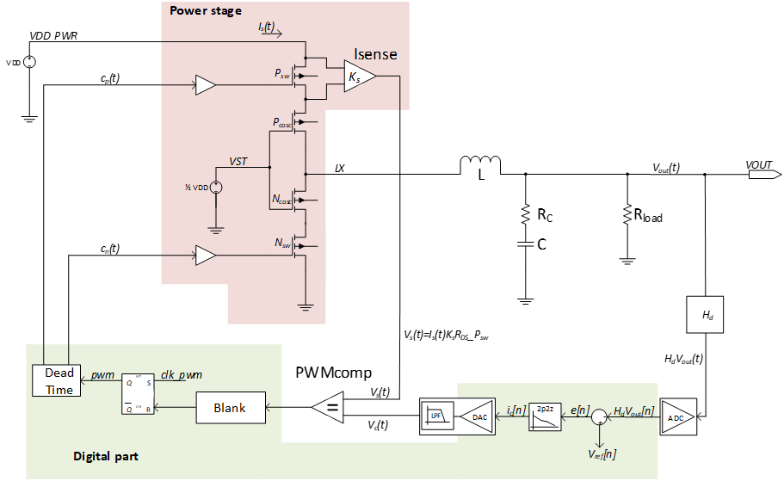
Next Gen DCDC High Level Architectural Diagram​

Slide 4
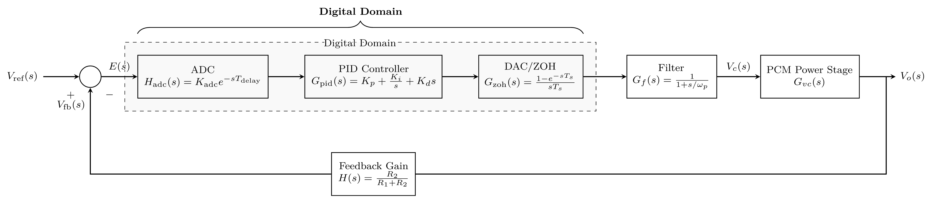
Small Signal Model

Slide 5
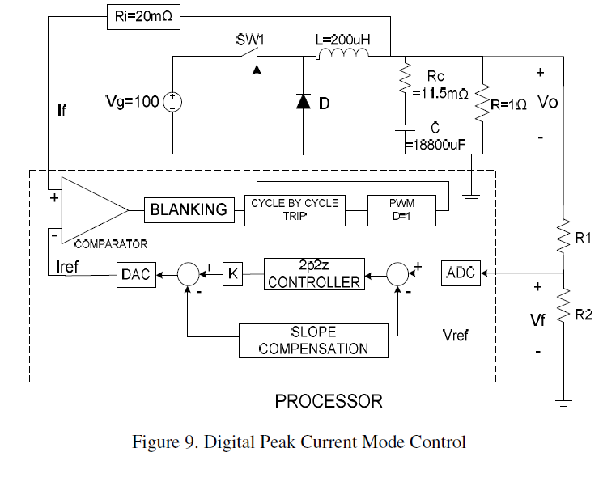
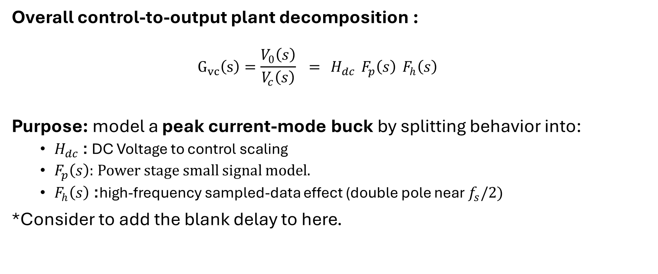
First Model – Derived From
Analysis and Modeling of Digital Peak Current
Mode Control
Overall control-to-output plant decomposition :
$$G_{vc}\left(s\right)=\frac{V_{0}\left(s\right)}{V_{c}\left(s\right)} = H_{dc} F_{p}\left(s\right) F_{h}\left(s\right)$$
Purpose: model a peak current-mode buck by splitting behavior into:
$H_{dc}$: DC Voltage to control scaling
$F_{p}\left(s\right):$Power stage small signal model.
$F_{h}\left(s\right)$: high-frequency sampled-data effect (double pole near $f_{s}/2)$
*Consider to add the blank delay to here.

Slide 6

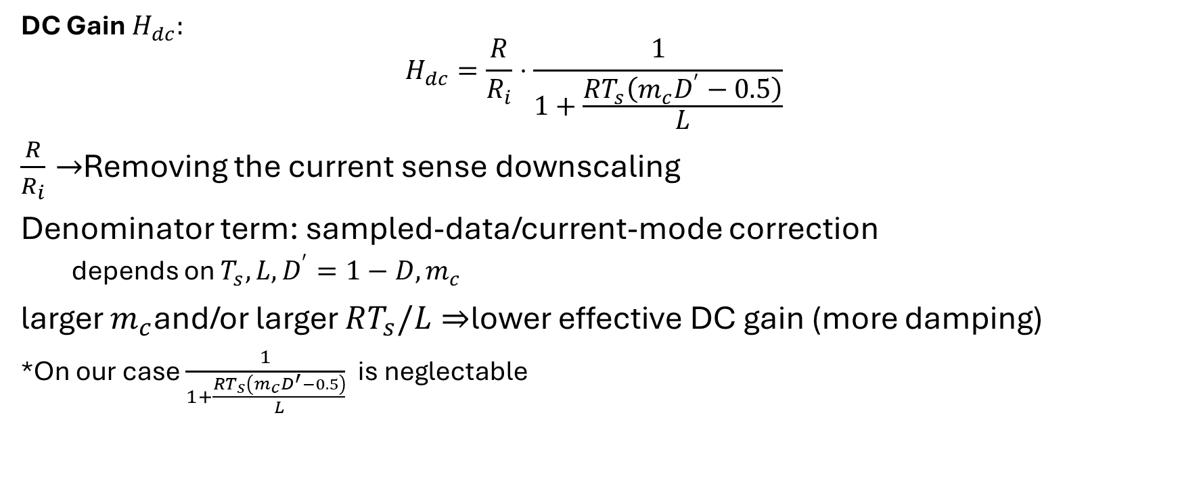
DC Gain $H_{dc}$
DC Gain $H_{dc}:$
$$H_{dc}=\frac{R}{R_{i}}⋅\frac{1}{1+\frac{RT_{s}\left(m_{c}D^{′}−0.5\right)}{L}}$$
$\frac{R}{R_{i}}→$Removing the current sense downscaling
Denominator term: sampled-data/current-mode correction
depends on $T_{s},L,D^{′}=1−D,m_{c}$
larger $m_{c}$and/or larger $RT_{s}/L$⇒ lower effective DC gain (more damping)
*On our case $\frac{1}{1+\frac{RT_{s}\left(m_{c}D^{′}−0.5\right)}{L}}$is neglectable

Slide 7
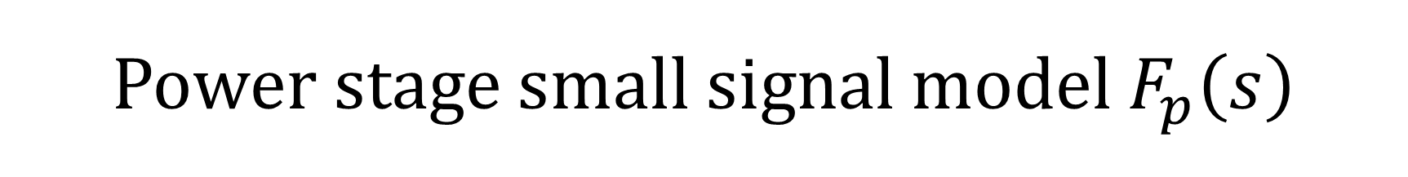
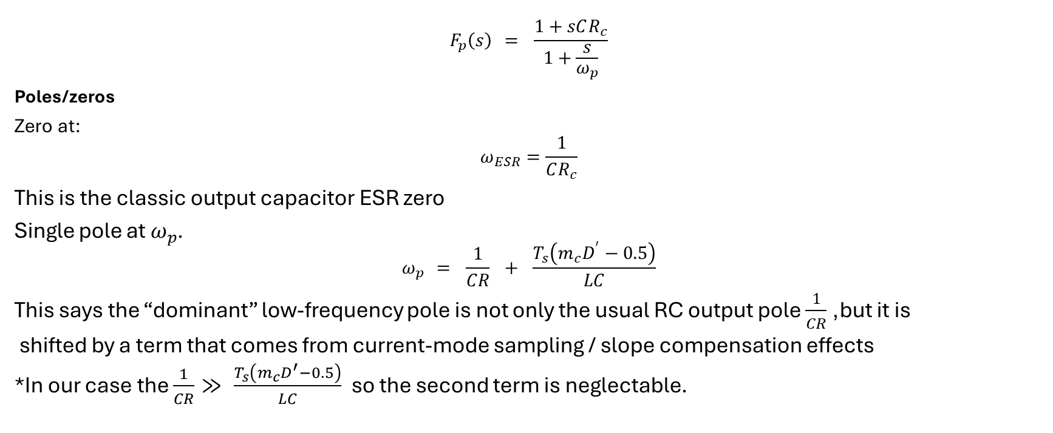
Power stage small signal model $F_{p}\left(s\right)$
$$F_{p}\left(s\right) = \frac{1+sCR_{c}}{1+\frac{s}{ω_{p}}}$$
Poles/zeros
Zero at:
$$ω_{ESR}=\frac{1}{CR_{c}}$$
This is the classic output capacitor ESR zero
Single pole at $ω_{p}$.
$$ω_{p} = \frac{1}{CR} + \frac{T_{s}\left(m_{c}D^{′}−0.5\right)}{LC}$$
This says the “dominant” low-frequency pole is not only the usual RC output pole $\frac{1}{CR}$, but it is
shifted by a term that comes from current-mode sampling / slope compensation effects
*In our case the $\frac{1}{CR}≫ \frac{T_{s}\left(m_{c}D^{′}−0.5\right)}{LC}$ so the second term is neglectable.

Slide 8

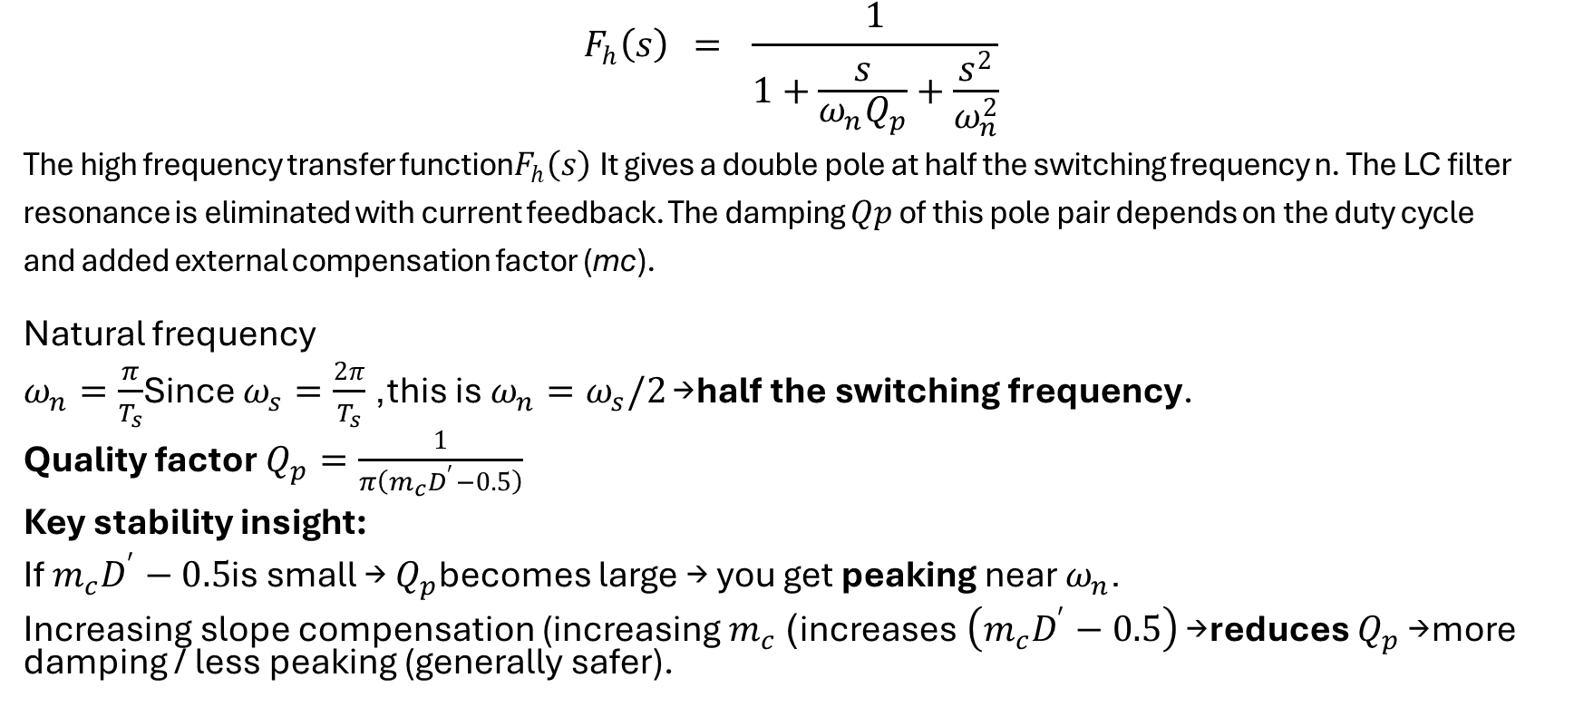
High-frequency factor $F_{h}\left(s\right)$
$$F_{h}\left(s\right) = \frac{1}{1+\frac{s}{ω_{n}Q_{p}}+\frac{s^{2}}{ω_{n}^{2}}}$$
The high frequency transfer function$F_{h}\left(s\right)$It gives a double pole at half the switching frequency n. The LC filter
resonance is eliminated with current feedback. The damping $Qp$ of this pole pair depends on the duty cycle
and added external compensation factor (mc).
Natural frequency
$ω_{n}=\frac{π}{T_{s}}$Since $ω_{s}=\frac{2π}{T_{s}}$, this is $ω_{n}=ω_{s}/2$→ half the switching frequency.
Quality factor $Q_{p}=\frac{1}{π\left(m_{c}D^{′}−0.5\right)}$
Key stability insight:
If $m_{c}D^{′}−0.5$is small → $Q_{p}$becomes large → you get peaking near $ω_{n}$.
Increasing slope compensation (increasing $m_{c}$) increases $\left(m_{c}D^{′}−0.5\right)$→ reduces $Q_{p}$→ more damping / less peaking (generally safer).

Slide 9
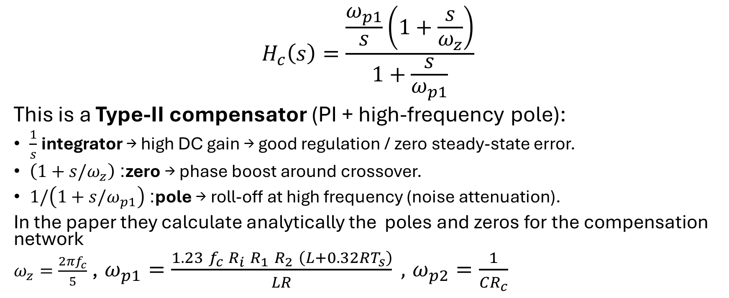
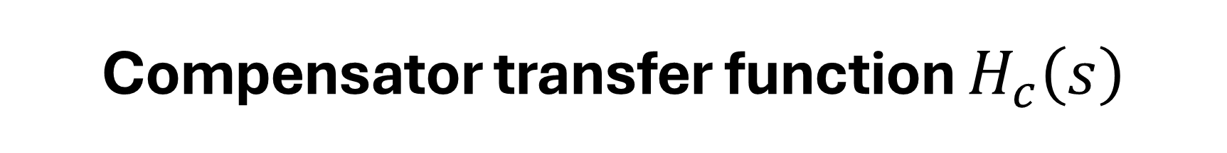
Compensator transfer function $H_{c}\left(s\right)$
$$H_{c}\left(s\right)=\frac{\frac{ω_{p1}}{s}\left(1+\frac{s}{ω_{z}}\right)}{1+\frac{s}{ω_{p1}}}$$
This is a Type-II compensator (PI + high-frequency pole):
$\frac{1}{s}$integrator → high DC gain → good regulation / zero steady-state error.
$\left(1+s/ω_{z}\right)$: zero → phase boost around crossover.
$1/\left(1+s/ω_{p1}\right)$: pole → roll-off at high frequency (noise attenuation).
In the paper they calculate analytically the poles and zeros for the compensation network
$ω_{z}=\frac{2πf_{c}}{5}$ , $ω_{p1}=\frac{1.23 f_{c} R_{i} R_{1} R_{2} \left(L+0.32RT_{s}\right)}{LR} ,$ $ω_{p2}=\frac{1}{CR_{c}}$

Slide 10
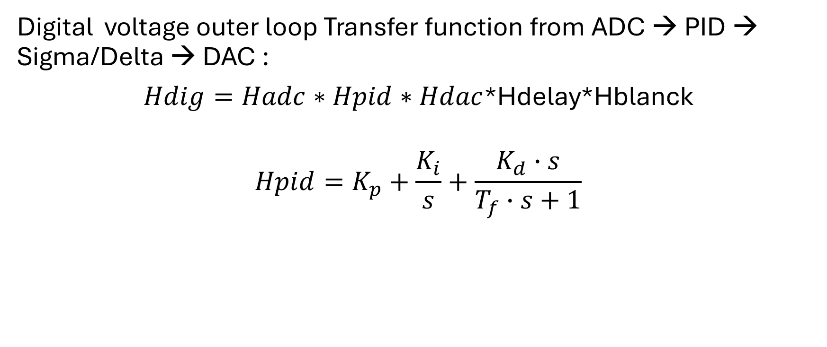
Digital Compensator transfer function
Digital voltage outer loop Transfer function from ADC → PID → Sigma/Delta → DAC :
$Hdig=Hadc∗Hpid∗Hdac$*Hdelay*Hblanck
$$Hpid=K_{p}+\frac{K_{i}}{s}+\frac{K_{d}∙s}{T_{f}∙s+1}$$

Slide 11
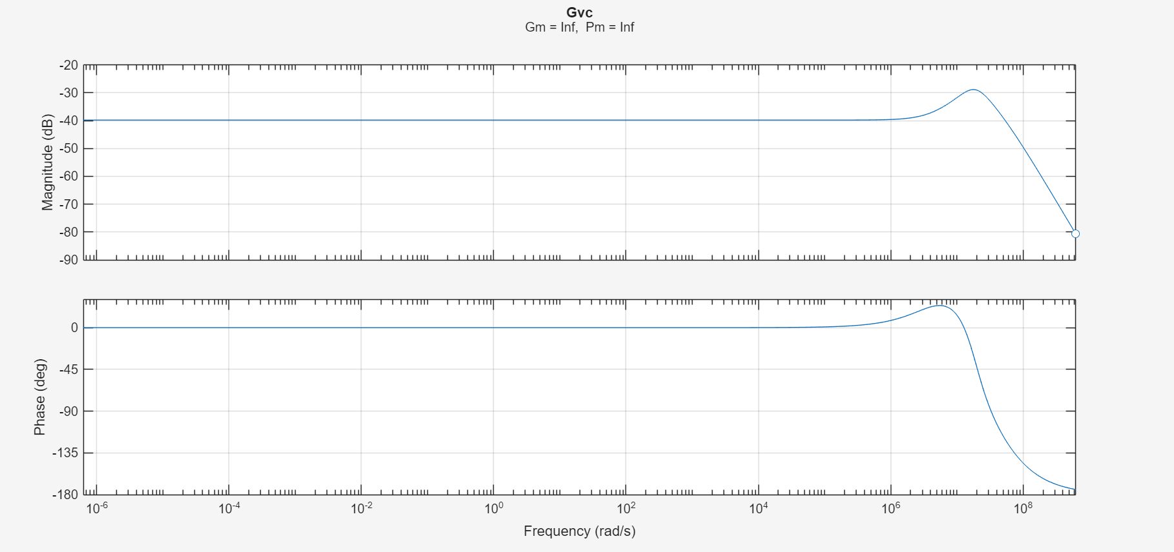

Calculated $Gvc(s)$

Slide 12
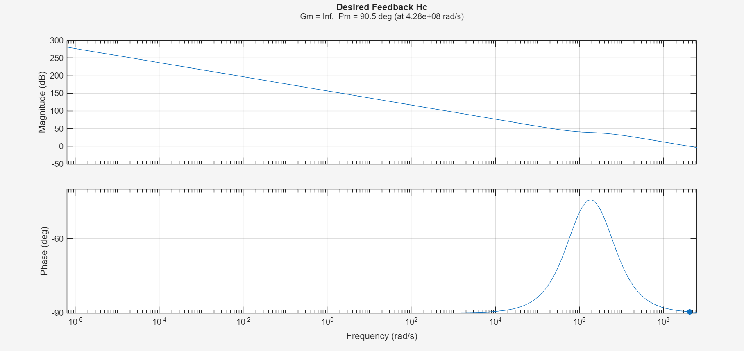

MATLAB Plots – Calculated $Hc(s)$

Slide 13
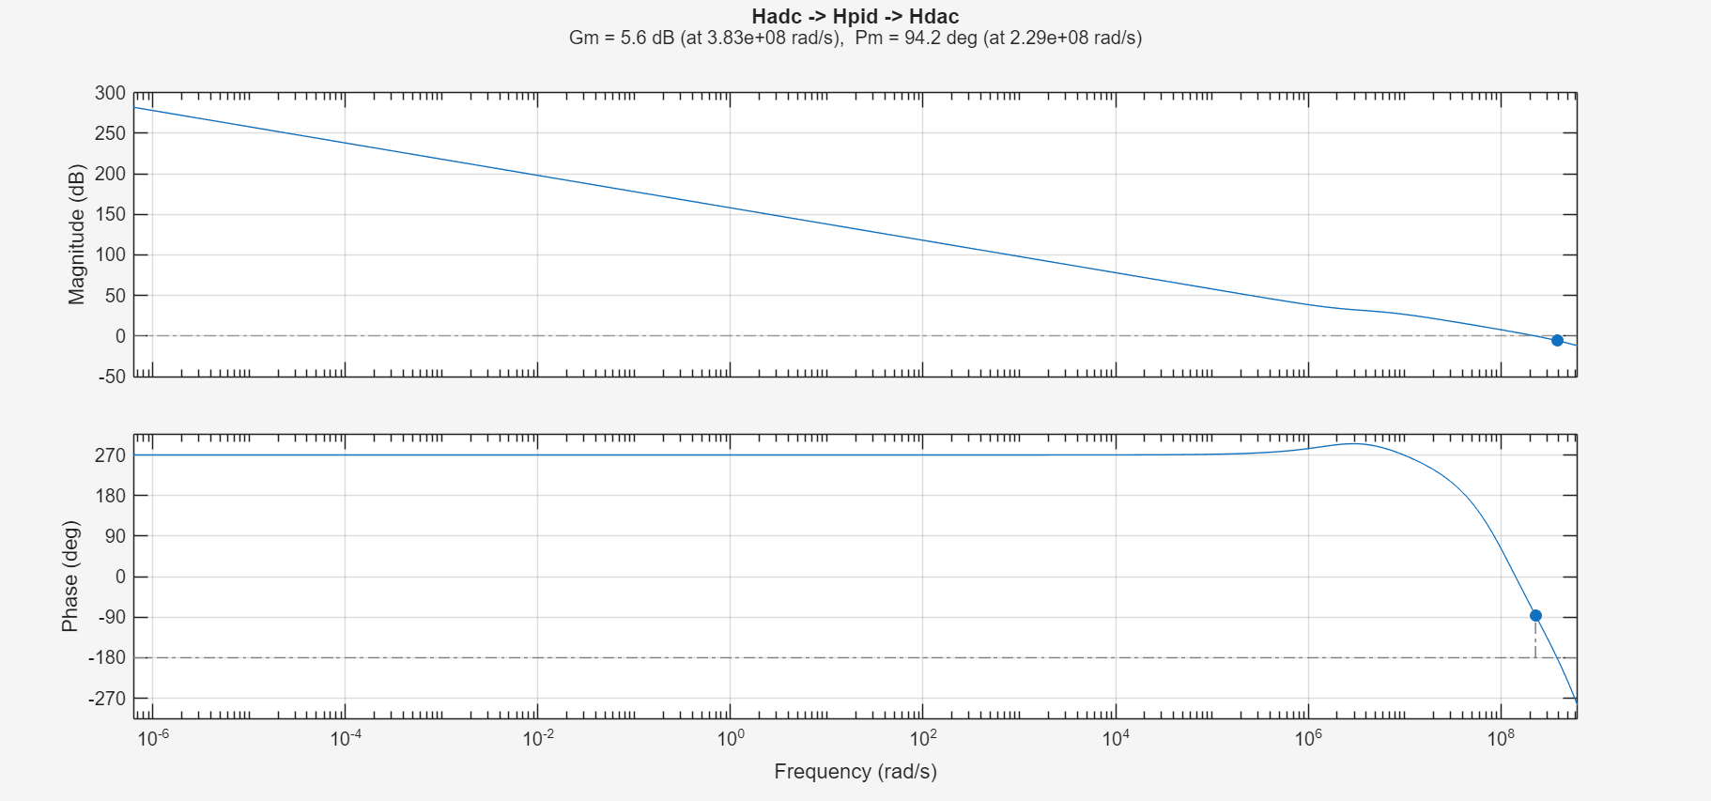
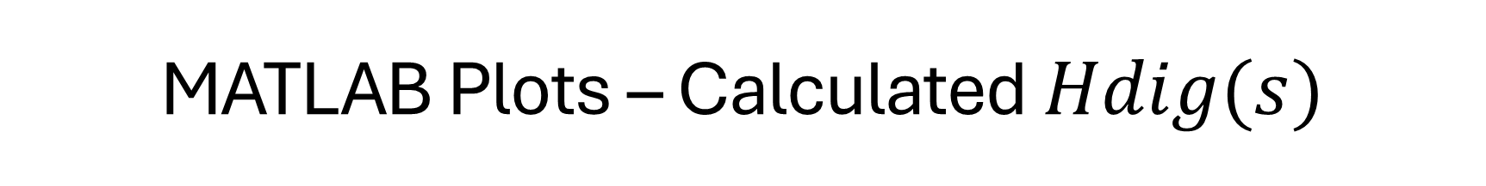
MATLAB Plots – Calculated $Hdig(s)$

Slide 14
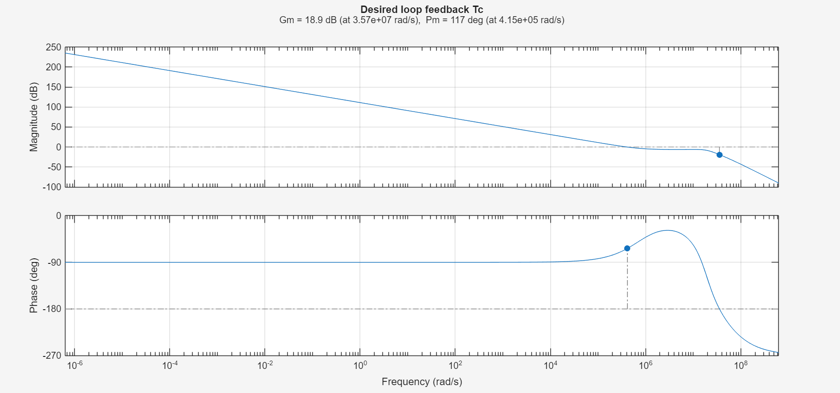
Theoretical FB loop transfer function T(s)

Slide 15
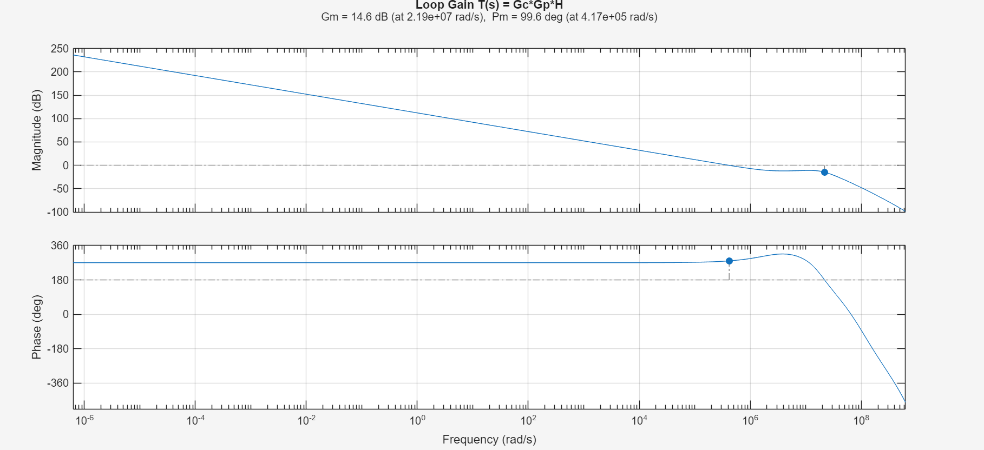
FB loop transfer function Tdig(s)

Slide 16
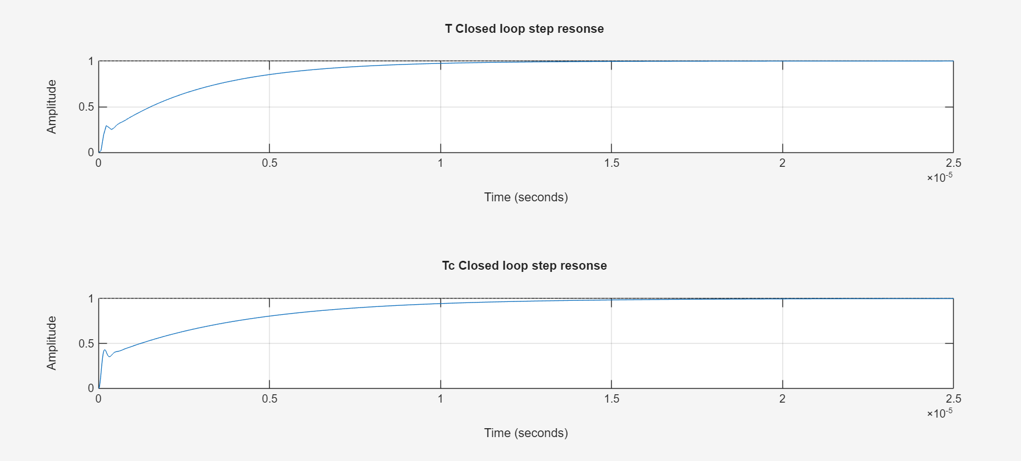
Closed loop step response comparison

Slide 17
AMS TB Required changes

Slide 18
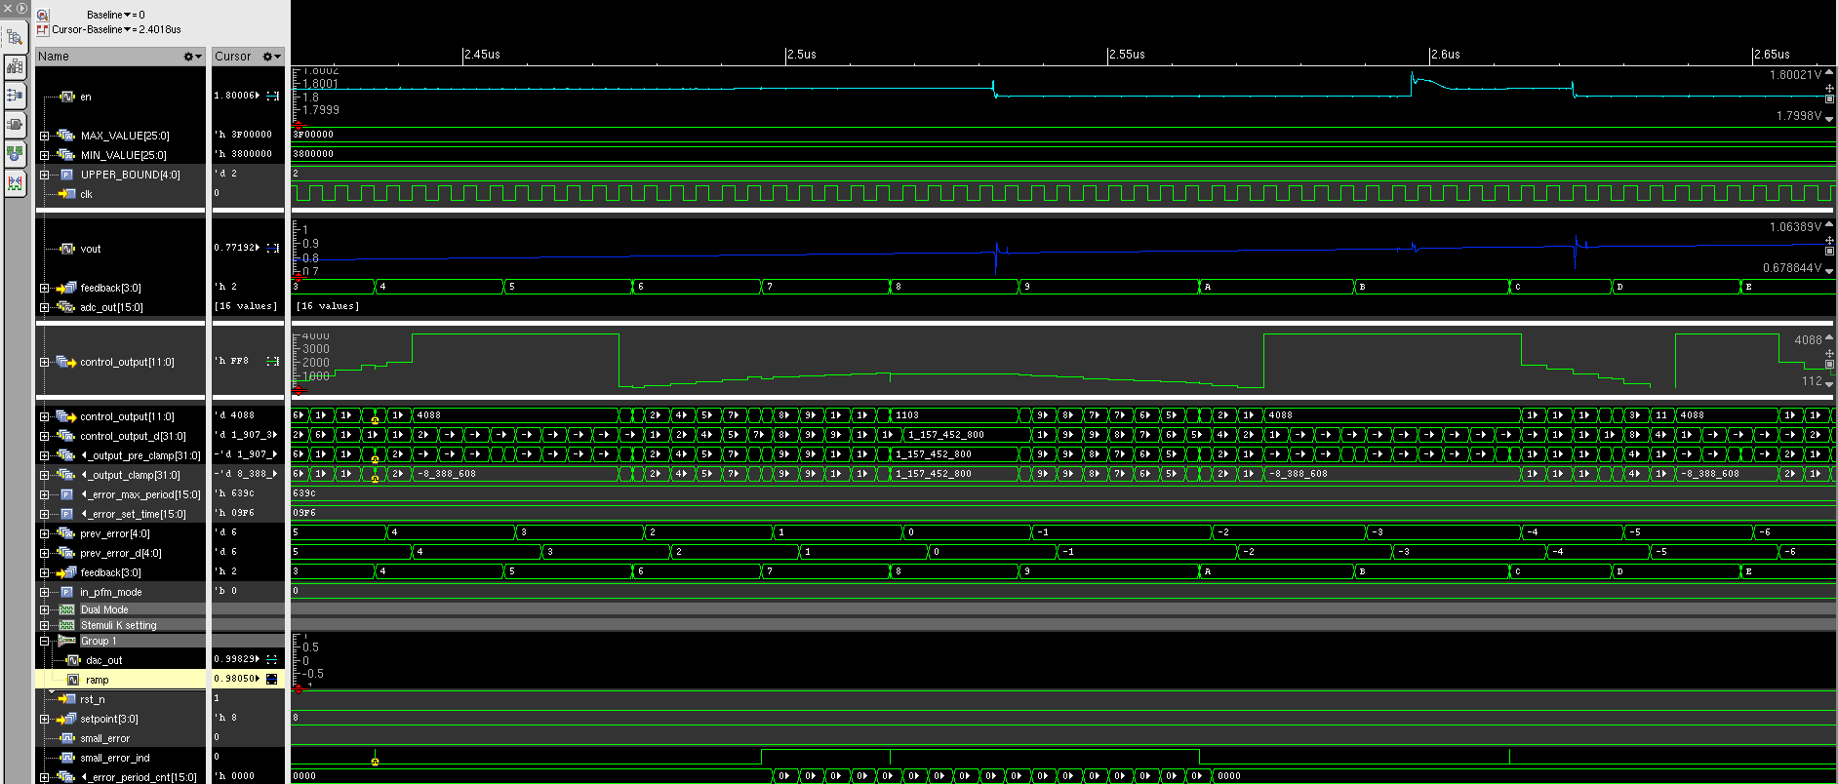
Updated the K1 and K2 Bits PID settings – MSB precalmb [31:8]

